Slide 1


Data Platform Service for North American Retail Client | Facebook CAPI API Integration
Third parties like Facebook and Google are increasingly blocked from collecting data on client websites and apps* So, capturing customers behavior as events and recognize customers and associate them to events created through their browsing behavior on client’s Digital Platform. Publicis Sapient helped in delivering an optimized program that helped to capture the customer information based on user content directly using combination of technologies. *IDFA Regulations

Slide 2

The transformative solution
Publicis Sapient helped in developing an application which would use data platform capabilities to capture & enrich customer information based on user content directly and support for analytics, visualizations, marketing and campaign.
Enriched data is leveraged to Target customers through FB Conversion API in real time.
P.S helped to modernize IT infrastructure so that they are ready to embrace digital challenge.
Customer interactions events trigged from Desktop, IOS, Android, Mobile browser through client owned tag
Leveraged Azure platform to handle millions of user's events to identify customer interactions and store in delta lake.

Slide 3
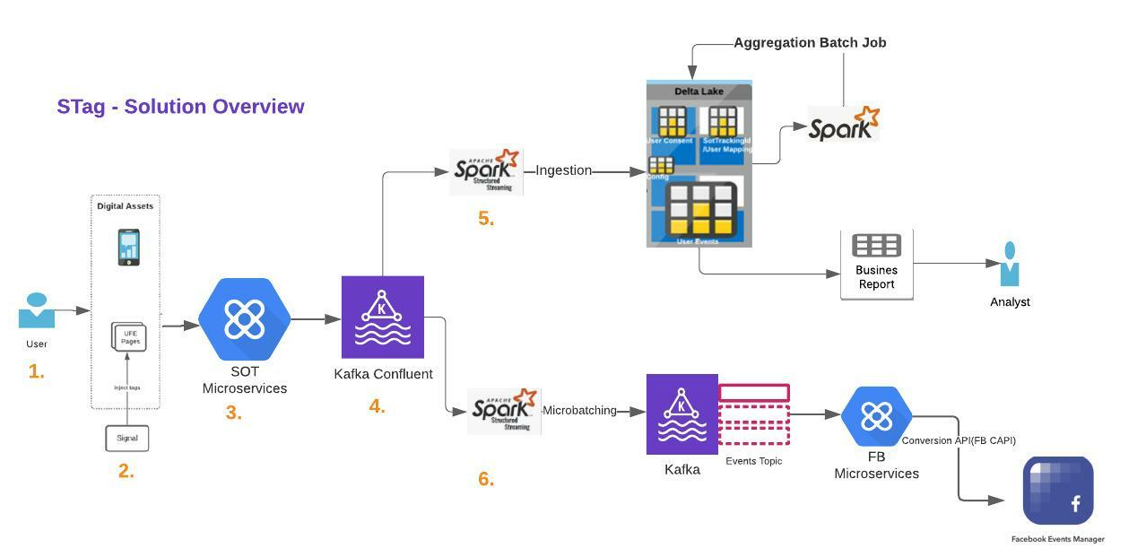
Data Platform Service | Facebook CAPI API Architecture

Slide 4

Business impact
Enable to capture data from Dotcom and App via configuration.
Solutions enable do site/app personalization without relying on a 3rd party.
To support real-time queries without adversely impacting the user experience.
Can share with 3rd parties who will lose access due to IDFA and other restrictive legislation/practices.

